Slide 1

Family-based multimarker Association Statistics : MTDT Hackathon
Tools and Web Services Work Package
IP Dakar
H3ABioNet AGM, 27 August 2020

Slide 2
Outline
Data design & Context rational
mTDT aims & use cases review
Hands-on session
Outputs discussion

Slide 3
Context Rational
Many studies in Africa with recruitment in families (trio, nuclear families data)
Study of Infectious disease (multifactorial diseases, complex traits)
Need statistical analysis methods and tools to handle data from such studies

Slide 4
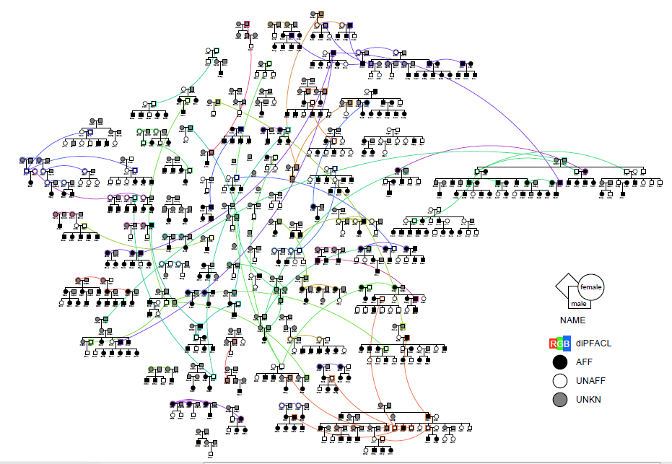
Family based design

Slide 5
AIMS
Global
To develop an open source program computing a family-based statistic testing for association between a phenotype and a set of multi-allelic markers
Specifics :
Handling of main statistical issues like:
non-specified distribution of traits
related individuals
population admixture
linkage disequilibrium among markers

Slide 6
M-TDT principle
Father
Offspring
Mother
Locus 1: Aa
Locus 2: Bb
Locus 3: CC
AA
bB
CC
Aa Locus 1
Bb Locus 2
CC Locus 3
Non-Affected
Aa
Bb
CC
aa
bb
CC
Aa
Bb
CC
Affected

Slide 7
M-TDT results
Ability to find joint effects of several markers impacting phenotypes in a context of small sample size
Retrieve markers that would be missed by classical approaches
Association with malaria resistant phenotype
GWAS Classic
1-TDT GWAS
M-TDT

Slide 8
M-TDT approach
Drawbacks:
Missing values
Increase in complexity leads to invadility of asymptotic test

Slide 9
M-TDT analysis tool diagram
M-TDT (Multilocus Transmission Disequilibrium Test)
Genotype inference
To reduce missingness
Family-based data design
Determine validity of asymptotic tests
Trios
Nuclear families
Complex families
Avoid systematic permutation tests
Gain of time
Minimize computational resources required
Run Analysis

Slide 10
Hands-on
3 STEPS
Run
Genotype
Inference
Run
M-TDT
tool
Install
environment

Slide 11
Install environment
You will need python
Download zipped file: https://github.com/avalanche-org/Gen_Assoc_Hackathon
Environment file Read INSTALLATION.md for assistance
Move file to your working directory
(MAC/Windows) (GNU/Linux)
conda activate sudo ./Linux_tools.sh
python setup_tools.py
Tools that will be installed: R and plink

Slide 12
Input file format
Data from a long-term malaria disease survey in two family-based cohorts in Dielmo and Ndiop research project in Senegal: 5000 autosomals snps of 481 individuals.
Two files are required to store genotypic data, the PED, MAP, PHEN files
Input file format: PLINK format "1 2" for allele codage
PED file has 6 fixed columns at the beginning followed by the SNP information. The columns should be separated by a whitespace or a tab.
Family ID (if unknown use the same id as for the sample id in column two)
Sample ID
Paternal ID (if unknown use 0)
Maternal ID (if unknown use 0)
Sex (if unknown use 0)
Affection
Rest of the columns: SNPs

Slide 13
Genotype Inference
About the Tool
Dependencies:
PLINK, R (optparse, foreach, doParallel)
Options:
--cores : number of cores to use for computing
--cutsize : size of SNPs' subsets
How to use it
Script and input files, .ped file, mendel_table.tsv
Command line example:
nohup Rscript genoInference.R --file myDataset --cutsize 50 --cores 2 &

Slide 14
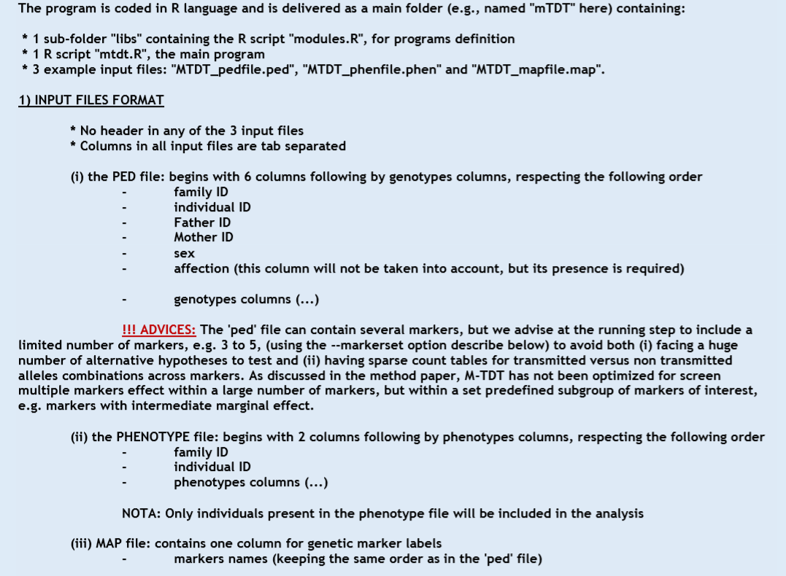
Readme file

Slide 15
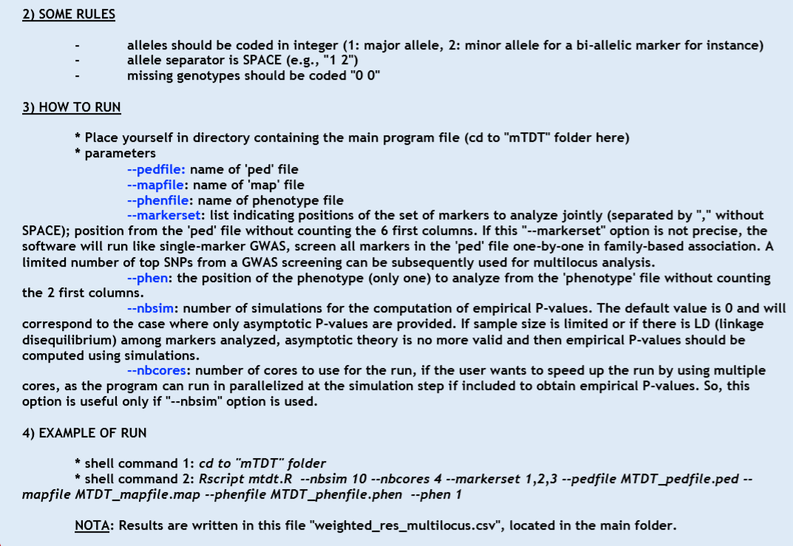
Readme file

Slide 16
MTDT
About the Tool
--pedfile: name of 'ped' file
--mapfile: name of 'map' file
--phenfile: name of phenotype file
--markerset: list indicating positions of the set of markers to analyze jointly (separated by "," without SPACE)
--phen: the position of the phenotype (only one) to analyze from the 'phenotype' file
--nbsim: number of simulations for the computation of empirical P-values. Default value : 0
--nbcores: number of cores to use for the run
How to run it
Script mTDT and input files: .ped, map, phen files
Command line example
cd to "mTDT" folder
Rscript mtdt.R --nbsim 10 --nbcores 4 --markerset 1,2,3 --pedfile MTDT_pedfile.ped -
mapfile MTDT_mapfile.map --phenfile MTDT_phenfile.phen --phen 1

Slide 17
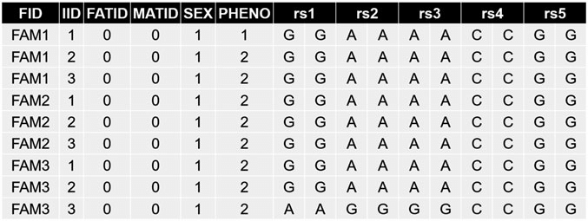
Run MTDT
Run genoinference.R
empirical
GI dataset
- Check mendel errors
theorical
Compare Outputs
Original dataset
empirical
1000 autosomals snps
Check mendel errors
We want to make an association between a set of multi-allelic markers and a phenotype
Original dataset
theorical

